Slide 1
Algorithms
Computer Science, Purdue University
Copyright McGraw Hill, Rosen, Discrete Mathematics and its Applications

Slide 2
Algorithms
Algorithms: Basics
The first step in solving a desired problem is to precisely state the problem, using the appropriate structures to specify the input and the desired output.
We then solve the specified problem by prescribing the steps of a procedure that takes a valid input and produces the desired output. This procedure is called an algorithm.
Computer Science, Purdue University

Slide 3
Algorithms
Algorithms: Basics
Definition: An algorithm is a finite set of precise instructions for performing a computation or for solving a problem.
Example: Describe an algorithm for finding the maximum value in a finite sequence of integers.
Solution: Perform the following steps:
Set the temporary maximum equal to the first integer in the sequence.
Compare the next integer in the sequence to the temporary maximum.
If it is larger than the temporary maximum, set the temporary maximum equal to this integer.
Repeat the previous step if there are more integers. If not, stop.
When the algorithm terminates, the temporary maximum is the largest integer in the sequence.
Computer Science, Purdue University

Slide 4
Algorithms
Algorithm Specification
Algorithms can be specified in different ways. Their steps can be described in English or in pseudocode.
Pseudocode is an intermediate step between an English language description of the steps and a coding of these steps using a programming language.
Programmers can use the description of an algorithm in pseudocode to construct a program in a particular language.
Pseudocode helps us analyze the time required to solve a problem using an algorithm, independent of the actual programming language used to implement algorithm.
Computer Science, Purdue University

Slide 5
Algorithms
Properties of Algorithms
Input: An algorithm has input values from a specified set.
Output: From the input values, the algorithm produces the output values from a specified set. The output values are the solution.
Correctness: An algorithm should produce the correct output values for each set of input values.
Finiteness: An algorithm should produce the output after a finite number of steps for any input.
Effectiveness: It must be possible to perform each step of the algorithm correctly and in a finite amount of time.
Generality: The algorithm should work for all problems of the desired form.
Computer Science, Purdue University

Slide 6
Algorithms
Algorithms: Finding the Maximum in a List of Numbers
The algorithm in pseudocode:
Does this algorithm have all the properties listed on the previous slide?
procedure max(a₁, a₂, …., a_{n}: integers)
max := a₁
for i := 2 to n
if max < a_{i} then max := a_{i}
return max{max is the largest element}
Computer Science, Purdue University

Slide 7
Algorithms
Algorithms: Examples
Three classes of problems will be studied in this segment.
Searching Problems: finding the position of a particular element in a list.
Sorting problems: putting the elements of a list into increasing order.
Optimization Problems: determining the optimal value (maximum or minimum) of a particular quantity over all possible inputs.
Computer Science, Purdue University

Slide 8
Algorithms
Algorithms: Searching
Definition: The general searching problem is to locate an element x in the list of distinct elements a₁,a₂,...,a_{n}, or determine that it is not in the list.
The solution to a searching problem is the location of the term in the list that equals x (that is, i is the solution if x = a_{i}) or 0 if x is not in the list.
For example, a library might want to check to see if a patron is on a list of those with overdue books before allowing him/her to checkout another book.
We will study two different searching algorithms; linear search and binary search.
Computer Science, Purdue University

Slide 9
Algorithms
Algorithms: Linear Search
The linear search algorithm locates an item in a list by examining elements in the sequence one at a time, starting at the beginning.
First compare x with a₁. If they are equal, return the position 1.
If not, try a₂. If x = a₂, return the position 2.
Keep going, and if no match is found when the entire list is scanned, return 0.
procedure linear search(x:integer, a₁, a₂, …,a_{n}: distinct integers)
i := 1
while (i ≤ n and x ≠ a_{i})
i := i + 1
if i ≤ n then location := i
else location := 0
return location{location is the subscript of the term that equals x, or is 0 if x is not found}
Computer Science, Purdue University

Slide 10
Algorithms
Algorithms: Binary Search
Assume the input is a list of items in increasing order.
The algorithm begins by comparing the element to be found with the middle element.
If the middle element is lower, the search proceeds with the upper half of the list.
If it is not lower, the search proceeds with the lower half of the list (through the middle position).
Repeat this process until we have a list of size 1.
If the element we are looking for is equal to the element in the list, the position is returned.
Otherwise, 0 is returned to indicate that the element was not found.
Computer Science, Purdue University

Slide 11
Algorithms
Algorithms: Binary Search
Here is a description of the binary search algorithm in pseudocode.
procedure binary search(x: integer, a₁,a₂,…, a_{n}: increasing integers)
i := 1 {i is the left endpoint of interval}
j := n {j is right endpoint of interval}
while i < j
m := ⌊(i + j)/2⌋
if x > a_{m} then i := m + 1
else j := m
if x = a_{i} then location := i
else location := 0
return location{location is the subscript i of the term a_{i} equal to x, or 0 if x is not found}
Computer Science, Purdue University

Slide 12
Algorithms
Algorithms: Binary Search
Example: The steps taken by a binary search for 19 in the list:
1 2 3 5 6 7 8 10 12 13 15 16 18 19 20 22
The list has 16 elements, so the midpoint is 8. The value in the 8th position is 10. Since 19 > 10, further search is restricted to positions 9 through 16.
1 2 3 5 6 7 8 10 12 13 15 16 18 19 20 22
The midpoint of the list (positions 9 through 16) is now the 12th position with a value of 16. Since 19 > 16, further search is restricted to the 13th position and above.
1 2 3 5 6 7 8 10 12 13 15 16 18 19 20 22
The midpoint of the current list is now the 14th position with a value of 19. Since 19 ≯ 19, further search is restricted to the portion from the 13th through the 14th positions .
1 2 3 5 6 7 8 10 12 13 15 16 18 19 20 22
The midpoint of the current list is now the 13th position with a value of 18. Since 19> 18, search is restricted to the portion from the 14th position through the 14th.
1 2 3 5 6 7 8 10 12 13 15 16 18 19 20 22
Now the list has a single element and the loop ends. Since 19=19, the location 14 is returned.
Computer Science, Purdue University

Slide 13
Algorithms
Algorithms: Sorting
To sort the elements of a list is to put them in increasing order (numerical order, alphabetic, and so on).
Sorting is an important problem because:
A nontrivial percentage of all computing resources are devoted to sorting different kinds of lists, especially applications involving large databases of information that need to be presented in a particular order (e.g., by customer, part number etc.).
An amazing number of fundamentally different algorithms have been invented for sorting. Their relative advantages and disadvantages have been studied extensively.
Sorting algorithms are useful to illustrate the basic notions of computer science.
Computer Science, Purdue University

Slide 14
Algorithms
Bubble Sort
Bubble sort makes multiple passes through a list. Every pair of elements that are found to be out of order are interchanged.
procedure bubblesort(a₁,…,a_{n}: real numbers with n ≥ 2)
for i := 1 to n− 1
for j := 1 to n − i
if a_{j} >a_{j+1} then interchange a_{j} and a_{j+1}
{a₁,…, a_{n} is now in increasing order}
Computer Science, Purdue University

Slide 15
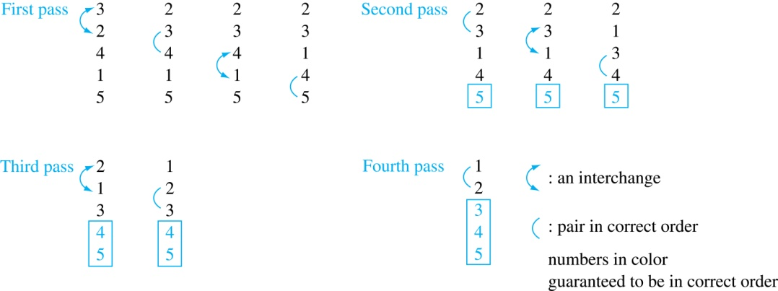
Algorithms
Bubble Sort
Example: Show the steps of bubble sort with 3 2 4 1 5
At the first pass the largest element has been put into the correct position
At the end of the second pass, the 2nd largest element has been put into the correct position.
In each subsequent pass, an additional element is put in the correct position.
Computer Science, Purdue University

Slide 16
Algorithms
Insertion Sort
Insertion sort begins with the 2nd element. It compares the 2nd element with the 1st and puts it before the first if it is not larger.
Next the 3rd element is put into the correct position among the first 3 elements.
In each subsequent pass, the n+1st element is put into its correct position among the first n+1 elements.
Linear search is used to find the correct position.
procedure insertion sort (a₁,…,a_{n}:
real numbers with n ≥ 2)
for j := 2 to n
i := 1
while a_{j} > a_{i}
i := i + 1
m := a_{j}
for k := 0 to j − i − 1
a_{j-k} := a_{j-k-1}
a_{i} := m
{Now a₁,…,a_{n} is in increasing order}
Computer Science, Purdue University

Slide 17
Algorithms
Insertion Sort
Example: Show all the steps of insertion sort with the input: 3 2 4 1 5
2 3 4 1 5 (first two positions are interchanged)
2 3 4 1 5 (third element remains in its position)
1 2 3 4 5 (fourth is placed at beginning)
1 2 3 4 5 (fifth element remains in its position)
Computer Science, Purdue University

Slide 18
Thank You

